Slide 1
Proactive Health Coaching –
Risk assessment and metrics
Workshop
September 2016

Slide 2
Background information
Health Navigator is an organisation focused on innovative behavioural interventions and offers a Proactive Health Coaching (PHC) service for patients with frequent non-elective admissions and A&E attendances
This material has been developed with the aim of increasing the understanding of PHC, and to give some background to the intervention
This material should be regarded as preliminary and confidential, and is only complete together with the relevant verbal presentation. This material should therefore not be distributed without prior agreement.
For more information about this material and PHC please contact Karin Hogsander (Interim Managing Director) at karin.hogsander@health-navigator.co.uk

Slide 3

Discuss in pairs for 5 minutes
What is your experience of health coaching, risk assessment and metrics?
Notes:
Joachim

Slide 4

Proactive Health Coaching (PHC) seeks to minimise avoidable care consumption and improve quality of life
Care consumption is highly concentrated to a small number of individuals
The most resource heavy group is dynamic
Support of health coach prevents high need for healthcare
Cost
Healthcare cost per patient
11%
Deceased
w/o coaching
34%
Over 10%
100%
34%
1-10%
20%
1%
w/
coaching
Number of individuals
2013
2014
Time
  1% of the population account for 30% of care consumption
  10% of the population account for 80% of care consumption
  Only 20% of patients are part of the most resource- heavy group for two consecutive years
  Complex group, no specific diagnosis
  Risk prediction model identifies patients before they become part of the 1%-group
  Support ends when need has decreased
Source: Swedish health care database VAL; Health Navigator
Notes:
Birger
Animerad

Slide 5

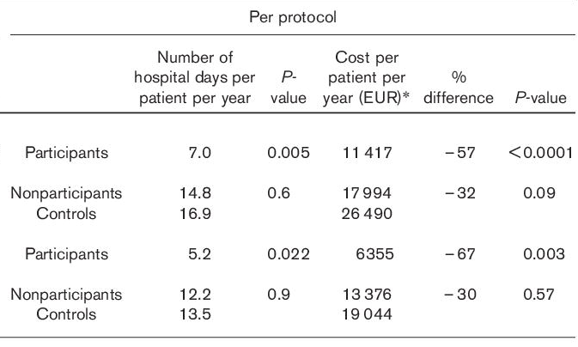


Earlier randomised controlled trial showed health care utilisation up to 30-50% lower in intervention group
  With proactive health coaching:
  30-50% lower health care utilisation
  10% lower risk for inpatient stay
  Improved quality of life

Slide 6
Consider question 1:
How do you measure success of your Health Coaching programme?
Notes:
Joachim

Slide 7



A good risk assessment model finds patients likely to be helped by health coaching and avoids those who are not
Animerad
Patients at increased risk of becoming high consumers of health care who are not suitable for PHC, e.g. patients with dementia or in palliative care
Patients at increased risk of becoming high consumers of health care which would be preventable with PHC
  All inhabitants in a region

Slide 8
Consider question 2:
How do you optimise the choice of participants – include and exclude the “right” ones?

Slide 9
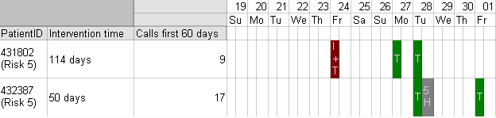
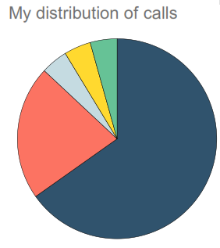
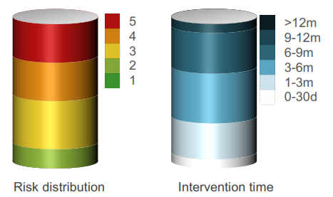
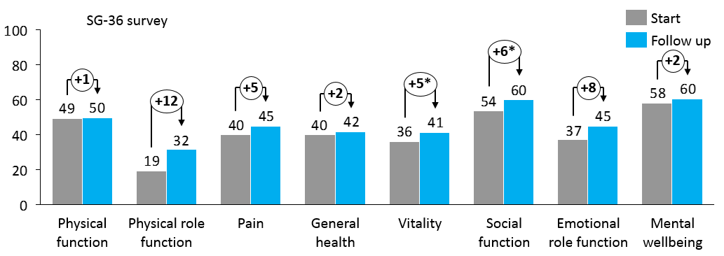
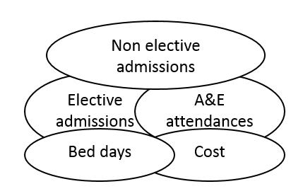
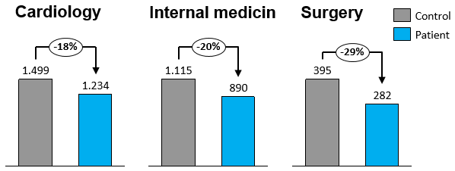
For metrics to help and be effieicnt, they need to span whole process and be part of holistic picture of progress
1
Internal reports
  Patient data for health coaches focused on preventable non elective admissions and A&E attendances
  Health coach performance in terms of how they focus their time; how and which patients that are assessed and followed up, and what is planned next
  Feedback
2
  Qualitative surveys of both physical and mental health
  Quantitative results of both elective and non elective care
  For evaluation and understanding
Outcomes
3
System level
  Strategic learnings to improve patient flow and shorten A&E waiting times
    e.g. identify patients for other types of support, e.g. home care

Slide 10
Consider question 3:
How do you measure and fine-tune internal, external and system metrics to reach success as smoothly as possible?

Slide 11
Discuss in pairs for 5 minutes
What have you learnt from the case study of Proactive Health Coaching? What can you take with you to your local health economy?
Notes:
Joachim

Slide 12
  Thank you!
Karin.hogsander@health-navigator.co.uk

